Slide 1
Metadata for Data Driven Organizations
Mandy Chessell, IBM

Slide 2
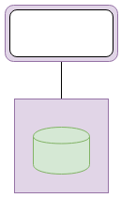
The challenge of information governance
Organization Silos
Notes:
So what is the challenge of information governance.
A horizontal capability that crosses the organization's silos.
Creates a need to design for the good of the whole which is contrary to the divide and conquer approach that most businesses adopt.

Slide 3
The challenge of information governance
I’m getting lots of value … Yippy!
I’m doing all of the work …
Data
Data
Data
Data
Organization Silos
Notes:
So what is the challenge of information governance.
A horizontal capability that crosses the organization's silos.
Creates a need to design for the good of the whole which is contrary to the divide and conquer approach that most businesses adopt.

Slide 4





How the data lake helps … direct services to the silos
Data Lake

Slide 5
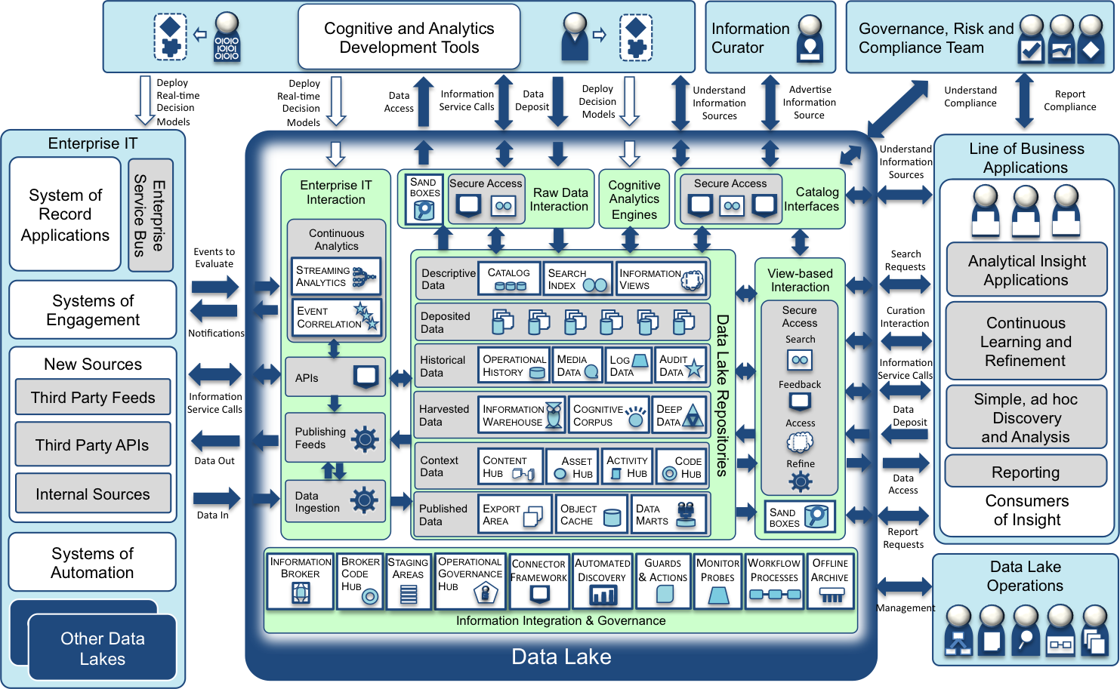
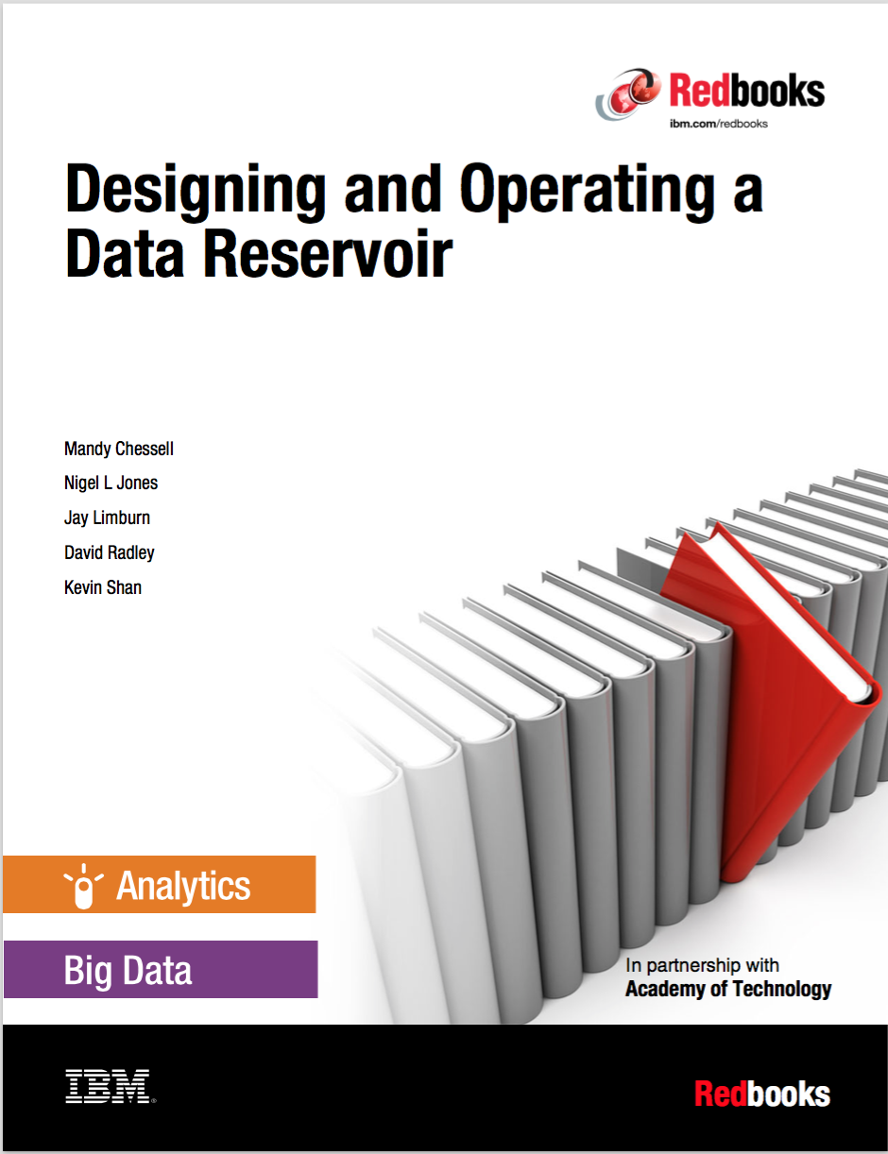
Data Lake – expanding the scope of data processed
http://www.redbooks.ibm.com/Redbooks.nsf/RedpieceAbstracts/sg248274.html?Open

Slide 6
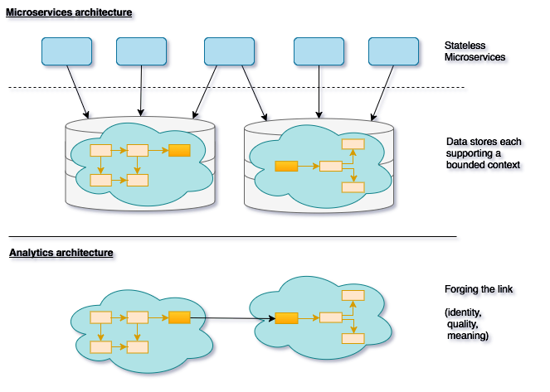
Data flows

Slide 7
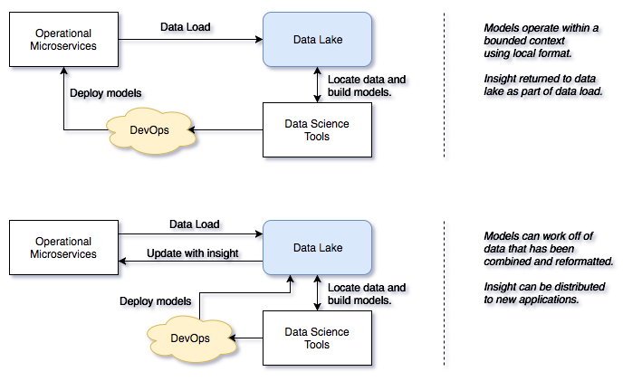
Data flows

Slide 8
Continuum of information transformation
Specific to the individual and task at hand
Information
Event
Information
User
Information
Trigger
Information
Process
Interchange of views
Information Service
Information Collection
Optimized for efficient storage and retrieval for many uses
√

Slide 9
The data driven organization …
Collaborating across all 3 lifecycles
Governance Teams
Policy
Policy
Audit
Define
Asset Owners
Enterprise Architecture
Monitor
Policy
Roll out
Classify
Operations
Policy
Metadata
Development
Stewards
Design
Execute
Business Users
Deploy
Developers
Detect
Remediate
Develop
Data Scientists
DevOps

Slide 10
Scope of metadata covered
Governance
Glossary
Collaboration
Models and
Reference Data
Lineage
Metadata
Discovery
Data Assets
Base Types, Systems
and Infrastructure

Slide 11
Scope of metadata covered
Strategy
4
Subject Area Definition
1
Teaming Metadata
(people profiles, communities, projects,
notebooks, …)
Policy Metadata (Principles, Regulations, Standards, Approaches, Rule Specifications, Roles and Metrics)
Business Objects and Relationships, Taxonomies and Ontologies
Augmentation
3
Organization
Feedback Metadata
(tags, comments, ratings, …)
Rollout
Classification
Business Attributes
Campaigns and Projects
Classification Schemes
Implementation
Mapping
Governance Actions and Processes
Rights
Management
Models and Schemas
2
Asset Collections
(Sets, Typed Sets, Type Organized Sets)
Reference Data
5
Instrument
7
Information Process
Instrumentation (design lineage)
Association
Information Views
Augmentation
Discovery
Metadata (profile data, technical classification, data classification,
data quality assessment, …)
Physical Asset Descriptions
(Data stores, APIs,
models and components)
0
Basic Types, Infrastructure and Systems
Access
6
Connectors

Slide 12
What does metadata look like?
Business
metadata
IS-A
Employee
Sensitive
HAS-A
Work Location
HAS-A
HAS-A
Hourly Pay Rate
Manager
Compensation Plan
HAS-A
IS-A
HAS-A
Job Title
IS-A
HAS-A
Employee Id
Annual Salary
Employee Name
Structural
metadata for
a data store
EmpName
EmpNo
JobCode
Salary
Employee Record
Data
00 3809890 6 7 Lemmie Stage 818928 3082 4 New York 4 27 DataStage Expert 1 45324 300 27 Code St Harlem NY 1 3
Notes:
Business metadata describes the data that the business needs, what it means and how it should be classified and protected.
Structural metadata describes how the data is actually stored and labelled in the data store.
The linkage between the business and technical metadata allows our technology to switch between these two perspectives. For example,
A request for data expressed in business terminology can be translated into a query for data from a data store.
An integration engine copying data into a sand box can discover which are the fields that the business classifies as sensitive and then mask these values dynamically.

Slide 13
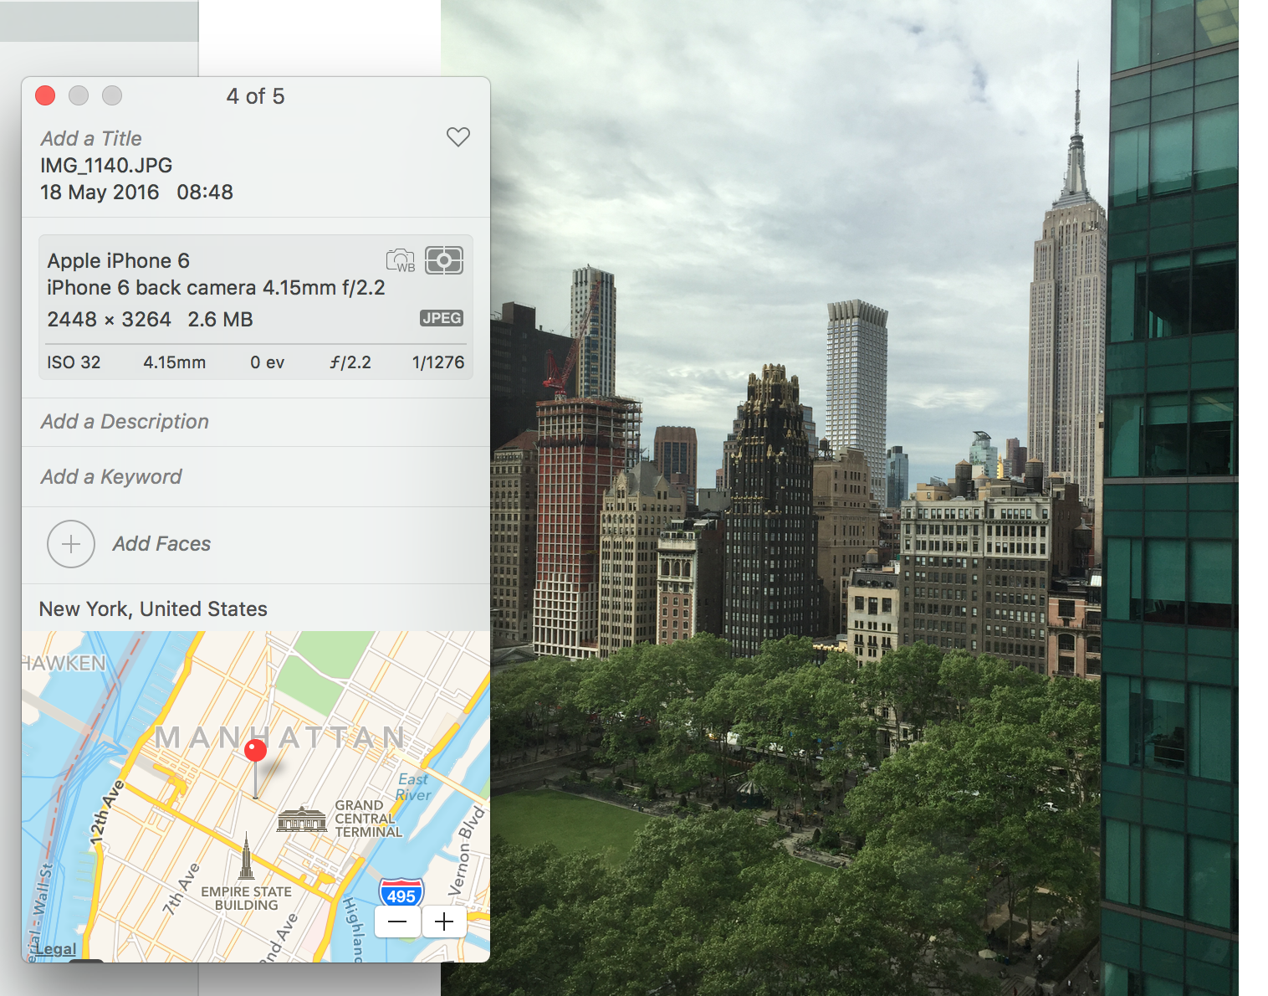
The value of open, standardized metadata
13
Notes:
AUTOMATED – Metadata is created by application at the same as the data is created in a standard manner easily consumable for all with necessary permissions
Device that took the picture / name of picture / settings picture was taken at / location geo tag of picture etc – all automatic – all done at creation of data time

Slide 14
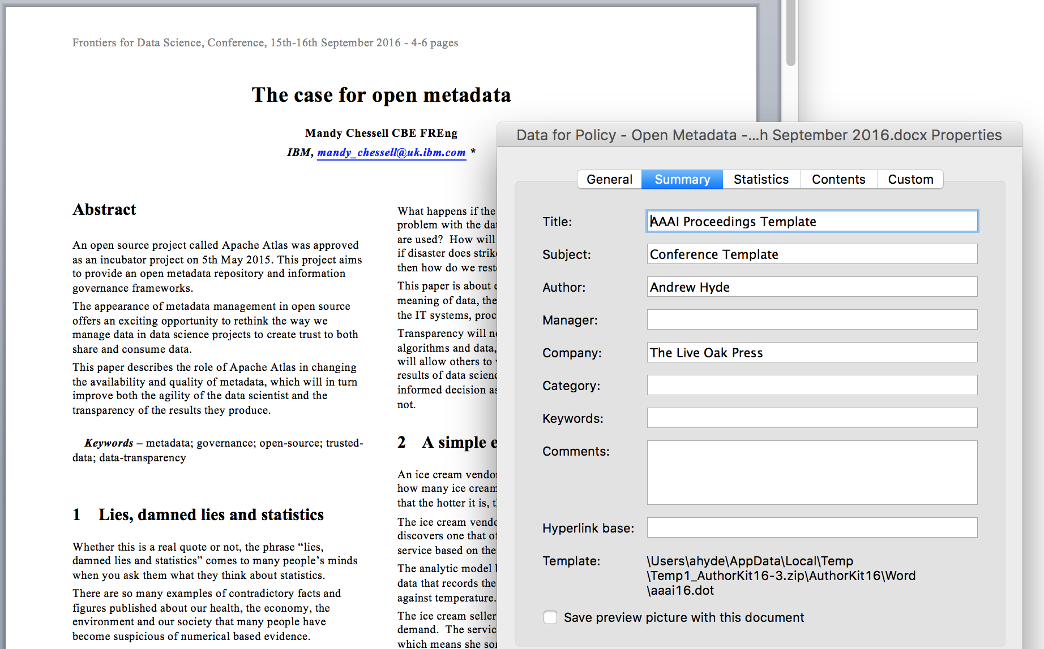
Manual metadata capture

Slide 15

Data needs to work harder …
Regulations and a need to operate a coherent, connected business made it necessary to extract data, combine it and use it in new contexts.
Data is now like a tortoise without its protected shell.
The infrastructure and people that support this data need to recreate the protected shell for their data.

Slide 16






Creating the protected shell
Knowledge and action (to scale)
Metadata captures the knowledge
Metadata driven technologies provide the action
Automation is needed to keep costs down and to ensure action is complete and consistent
However business agility is critical
Enable the adoption of new technologies and techniques as appropriate.

Slide 17
Using a metadata repository to describe data
Metadata
Repository

Slide 18
Today’s reality – organizations buy lots of tools

Slide 19
A new manifesto for metadata and governance
The maintenance of metadata must be automated to scale to the sheer volumes and variety of data involved in modern business. Similarly the use of metadata should be used to drive the governance of data and create a business-friendly logical interface to the data landscape.
The availability of metadata management must become ubiquitous in cloud platforms and large data platforms, such as Apache Hadoop so that the processing engines on these platforms can rely on its availability and build capability around it.
Metadata access must become open and remotely accessible so that tools from different vendors can work with metadata located on different platforms. This implies unique identifiers for metadata elements, some level of standardization in the types and formats for metadata and standard interfaces for manipulating metadata.
Wherever possible, discovery and maintenance of metadata has to an integral part of all tools that access, change and move information.

Slide 20
ODPi Egeria enables exchange of metadata between tools from different vendors
Development
DevOps
Data Science
Open and
Unified Metadata

Slide 21
A hybrid multi-cloud world
Independent metadata Repository
New applications deployed to cloud
Mobile Apps
IoT devices and
systems
Business Partners
Sharing data
Linked metadata Repositories
Data Lake
Applications
Databases
Files
Applications

Slide 22
Open metadata ecosystem
Independent metadata Repository
New applications deployed to cloud
Mobile Apps
IoT devices and
systems
Business Partners
Sharing data
Linked metadata Repositories
Data Lake
Applications
Databases
Files
Applications

Slide 23
Example of a simple cohort
Data Lake
Cohort A
Chief Data Office
Systems of Record

Slide 24
Connecting to multiple cohorts
Data Lake
Marketing
Data Lake
Cohort A
Cohort B
Chief Data Office
Systems of Record
Systems of Record
Mobile
Apps

Slide 25
Importance of the distributed graph model
Database
Column
Glossary Term
Server 1
Server 2
Entity
Entity

Slide 26
Importance of the distributed graph model
Database
Column
Glossary Term
Glossary
Term
Meaning
Server 1
Server 2
Reference
Copy
Relationship

Slide 27
Importance of the distributed graph model
Database
Column
Glossary
Term
Server 1
Server 2
Database Column
Glossary
Term
Meaning
Server 3

Slide 28
Coco Pharmaceuticals persona
https://odpi.github.io/data-governance/coco-pharmaceuticals/personas/

Slide 29


Different personas need different services
Callie Quartile
Data Scientist
Find data
Understand data
Manage analytics models
Build data strategy
Define governance program
Monitor progress
Jules Keeper
Chief Data Officer

Slide 30


Different personas need different services
Tanya Tidie
Clinical Trials Administrator
Maintain accurate patient records
Catalog clinical trials data
Demonstrate good data management practices
Understand risks to organization
Set up protection
Monitor for suspicious activity
Ivor Padlock
Chief Security Officer

Slide 31
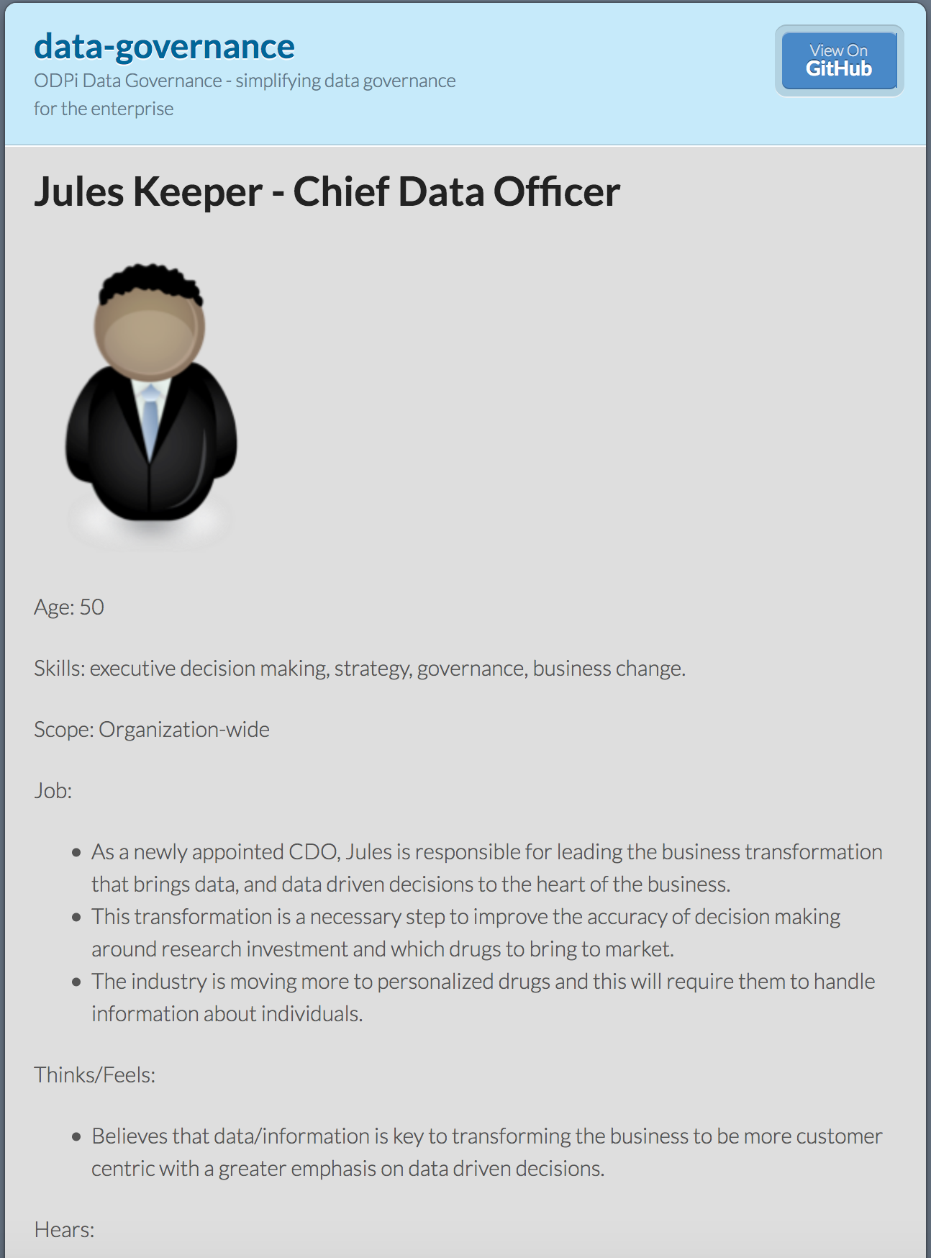
Using design thinking
Understanding the new roles that a data driven organization needs
Open Metadata Types
Service Identification
Samples and API design
Best Practices

Slide 32


Event-driven governance
Assign
Owner
New
Database
Open
Metadata
Classify
Data
Use
Data

Slide 33
Minimising integration costs
Use cases,
Personas,
Practitioners
input
Search
Open Metadata Access Services
Open Metadata Repository Services
Data integration, availability and integrity best practices
Notes:
The internal architecture of Egeria has two distinct layers.
The Open Metadata Access Services layer supports the different types of user and use case.
The Open Metadata Repository Services layer provides the unified view of metadata across distinct systems, using protocols and repositories for access and exchange of metadata objects.
Egeria’s OMRS layer includes the ability to refer to remote objects or replicate cached copies of remote objects for performance and availability
Egeria can store this distributed model in its own local repositories, which support the storing of:
local objects,
replicas of remote objects and
proxy-references to remote objects.

Slide 34
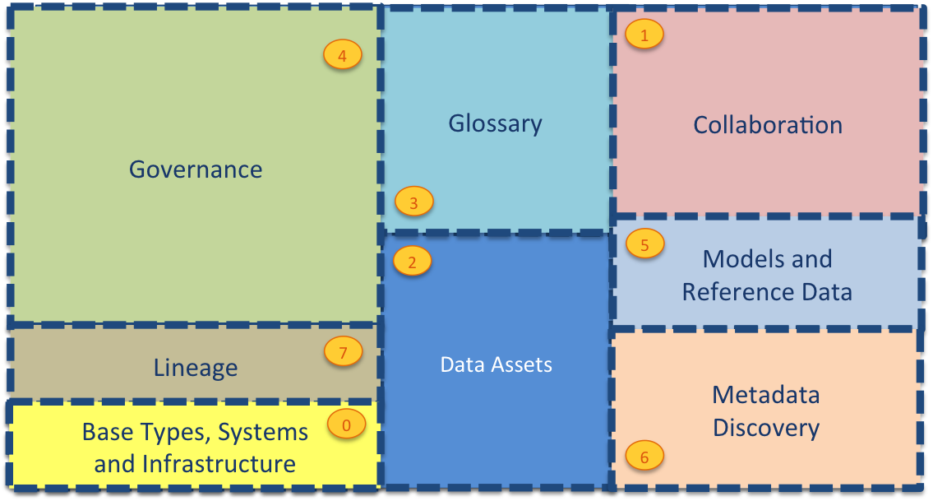
Current Open Metadata Access Services (OMASs)
Asset Consumer
Asset Owner
Asset Lineage
Subject Area
Asset Catalog
Community Profile
Stewardship Action
Project Management
Information View
Data Science
Governance Program
Software Developer
Data Privacy
Digital Architecture
Data Process
Data Protection
DevOps
Governance Engine
Data Infrastructure
Data Platform
Connected Asset
Discovery Engine

Slide 35

Capturing data sources
Data Platform
Server
Metadata
Server
RDBMS
Data Platform OMAS
Poll
Apache Cassandra
Listen
Asset Owner OMAS
Avro Files

Slide 36
Adding governance servers
Data Virtualization
Virtualizer
Data Lake
Chief Data Office
Metadata Server
Apache Ranger
Security-Sync
Cohort A
Metadata Server
Stewardship
Proxy
Data Platform
Systems of Record
Metadata
Server
Discovery
Stewardship
Data Onboarding

Slide 37
Open forum
z
z
z
z
z
z
z
Questions?

Slide 38
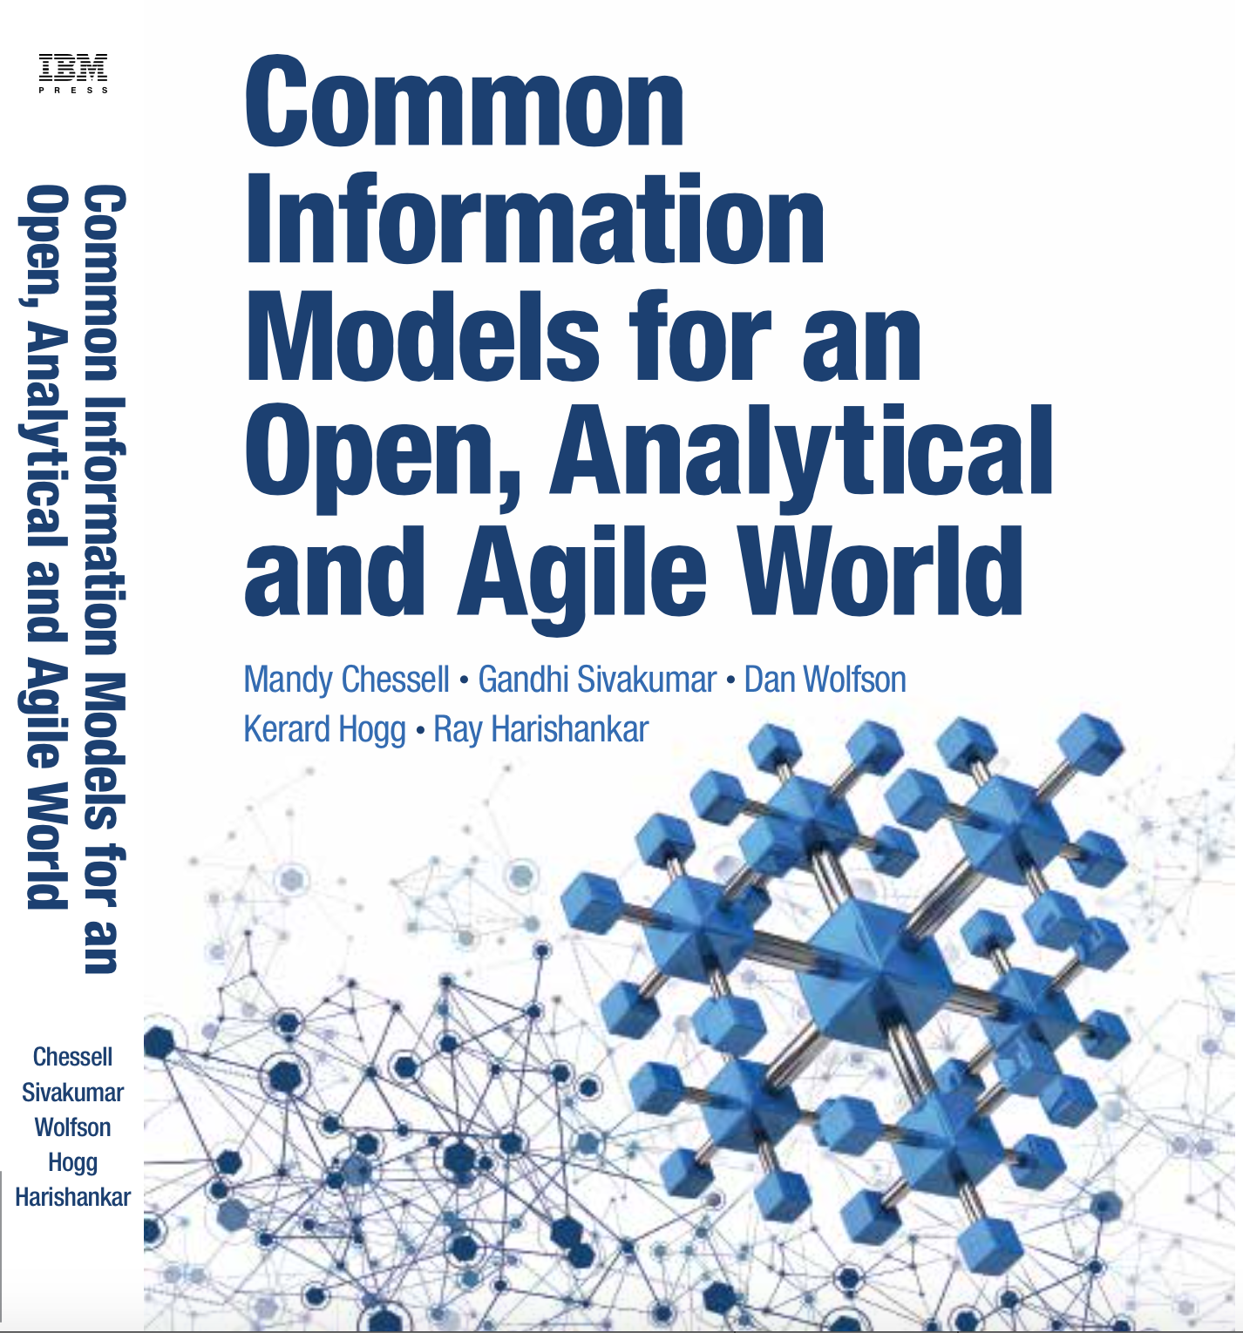
Common Information Models for an Open, Analytical and Agile World
To drive maximum value from complex IT projects, IT professionals need a deep understanding of the information their projects will use. Too often, however, IT treats information as an afterthought: the “poor stepchild” behind applications and infrastructure. That needs to change. This book will help you change it.
Using a complete case study, the authors explain what CIMs are, how to build them, and how to maintain them. You learn how to clarify the structure, meaning, and intent of any information you may exchange, and then use your CIM to improve integration, collaboration, and agility.
In today’s mobile, cloud, and analytics environments, your information is more valuable than ever. To build systems that make the most of it, start right here.

Slide 39
Links
Press Release and Podcast
Open source repositories
https://www.linuxfoundation.org/press-release/2018/08/odpi-announces-egeria-for-open-sharing-exchange-and-governance-of-metadata/
https://roaringelephant.org/2018/09/25/episode-107-open-metadata-and-governance-masterclass-with-mandy-chessell-part-1/
https://roaringelephant.org/2018/10/09/episode-109-open-metadata-and-governance-
masterclass-with-mandy-chessell-part-2/
https://github.com/odpi/data-governance
https://github.com/odpi/egeria

Slide 40
